Slide 1


Showcasing Data Projects and Learning Milestones
Welcome! This presentation highlights key data projects and learning milestones that demonstrate my passion for data-driven problem-solving and expertise in data analysis and application development. We'll explore a range of projects, including a credit card financial dashboard and a pharmacy management system, showcasing how I leveraged my skills to deliver impactful results.
by Ammar Pathan

Slide 2
Credit Card Financial Dashboard: Insights through Power BI and PostgreSQL
Data Exploration
Actionable Insights
This project involved analyzing a large dataset of credit card transactions using PostgreSQL, a powerful open-source database management system. I conducted data cleaning, transformation, and aggregation to prepare the data for visualization.
I then leveraged Power BI, a robust business intelligence tool, to create a dynamic dashboard that provided actionable insights into customer spending patterns, profitability, and key performance indicators. This dashboard enabled stakeholders to make data-driven decisions and optimize business strategies.

Slide 3

Pharmacy Management System: Streamlining Operations with SQL and Python
Inventory Management
Prescription Tracking
Automation and Integration
This project involved developing a pharmacy management system using SQL and Python to streamline inventory tracking and prescription management. I implemented a database to manage medication stock levels, expiry dates, and reorder points.
The system included features for managing patient prescriptions, tracking refills, and generating reports for pharmacy staff. This improved efficiency and accuracy, ensuring timely medication delivery and reduced errors.
I integrated Python scripts to automate tasks like inventory updates and generating reports. This automated process reduced manual effort and freed up staff for other important tasks.

Slide 4



Passion for Data-Driven Problem Solving
Data Analysis
I'm passionate about using data to solve real-world problems. This passion drives me to continuously learn and expand my knowledge and skills in data analysis and application development.
1
Problem Solving
2
My goal is to leverage my expertise to create impactful solutions that improve efficiency, optimize processes, and drive better outcomes for businesses and organizations.
Impact
3
I believe that data-driven insights are essential for making informed decisions and creating positive change in the world.

Slide 5
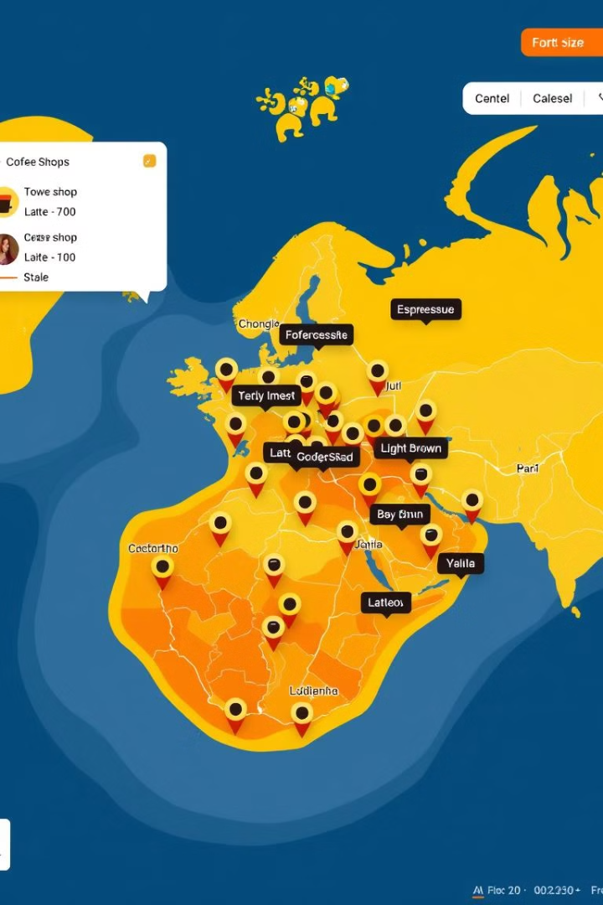



Leveraging Visualization to Drive Actionable Insights
Data Visualization
Effective data visualization is crucial for communicating complex insights in a clear and understandable way. I'm skilled in using various visualization tools to create engaging and informative dashboards and reports.
Storytelling with Data
By leveraging interactive visualizations, I can effectively convey stories and patterns within data, allowing stakeholders to quickly grasp key trends and make informed decisions.
Actionable Insights
My focus is on creating visualizations that drive action and lead to positive change. I strive to present data in a way that is both insightful and actionable.

Slide 6
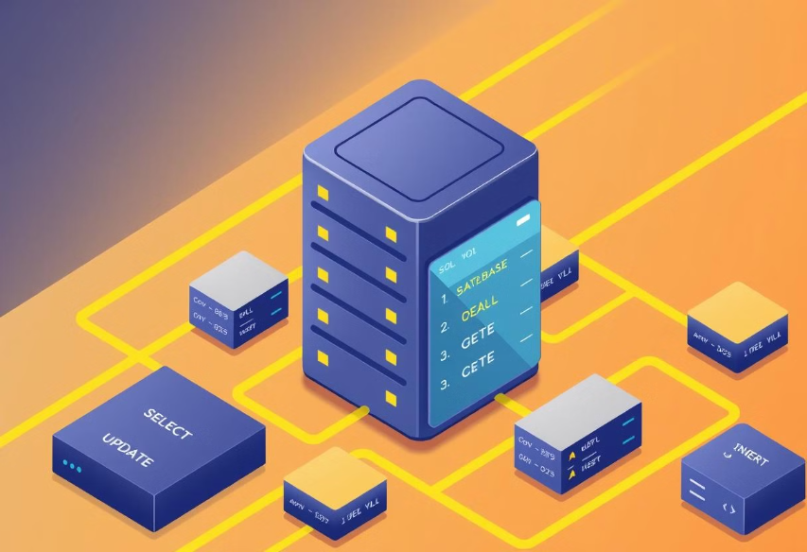
Mastering SQL and Database Management
1
2
3
1
Data Manipulation
I am proficient in SQL, a powerful language used for querying, manipulating, and managing data in relational databases. I have a solid understanding of SQL syntax, functions, and database design principles.
2
Database Management
I have experience working with different database management systems, including PostgreSQL and MySQL, and can effectively design, implement, and maintain robust and scalable databases.
3
Data Integrity
I prioritize data integrity and security, ensuring that data is accurate, consistent, and protected from unauthorized access.

Slide 7




Developing Scalable Python Applications
Python Proficiency
I have extensive experience in Python programming, a versatile language widely used for data analysis, web development, and automation. I am familiar with various Python libraries and frameworks.
Application Development
I can develop scalable and maintainable Python applications, incorporating best practices for code organization, testing, and deployment.
Data Processing and Automation
I utilize Python for data processing, automation, and scripting tasks, automating repetitive processes and streamlining workflows.

Slide 8

Applying Machine Learning for Predictive Analytics
1
Model Selection
I have a strong foundation in machine learning concepts and algorithms. I can select and apply appropriate models for predictive analytics, considering the specific problem and dataset.
2
Model Training
I am proficient in training machine learning models using various techniques, including supervised, unsupervised, and reinforcement learning, to achieve optimal performance.
3
Prediction and Evaluation
I can effectively evaluate model performance, identify areas for improvement, and deploy models for making predictions and generating actionable insights.

Slide 9

Continuous Learning and Skill Development
1
Stay Updated
2
Skill Enhancement
The field of data science is constantly evolving, with new technologies and techniques emerging. I am committed to continuous learning and staying updated with the latest trends.
I actively seek opportunities to enhance my skills through online courses, workshops, conferences, and engaging with the data science community.
3
Knowledge Sharing
I believe in sharing my knowledge and experience with others, contributing to the growth of the data science community.

Slide 10

Next Steps: Seeking Opportunities to Apply Expertise
I am eager to apply my skills and experience in challenging and impactful data projects. I am actively seeking opportunities to work with organizations that are committed to leveraging data to drive innovation and make a positive impact on the world.

